Slide 1



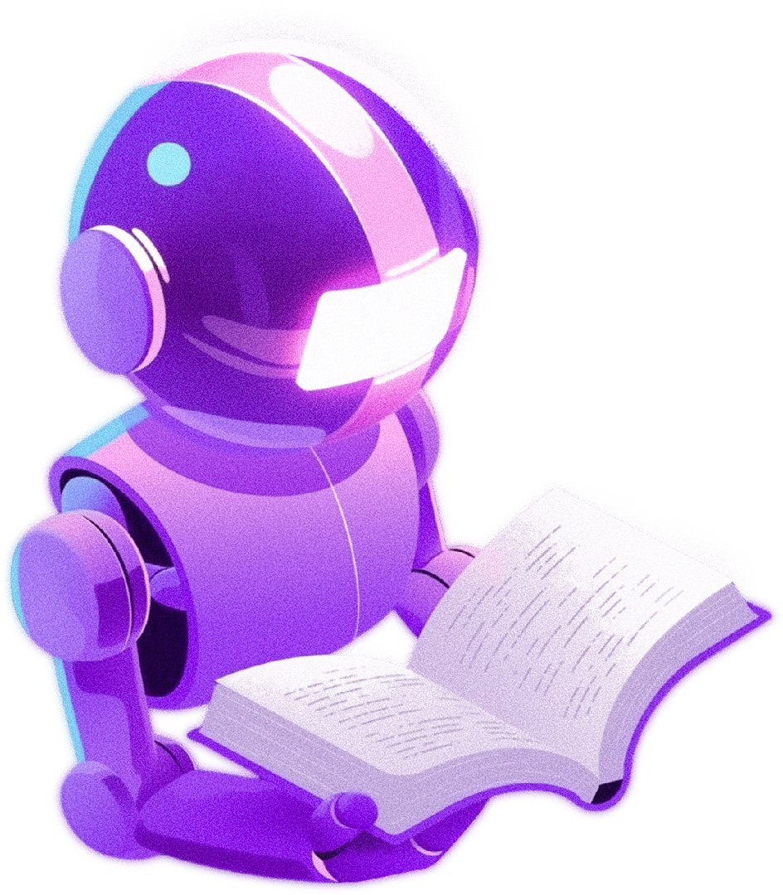
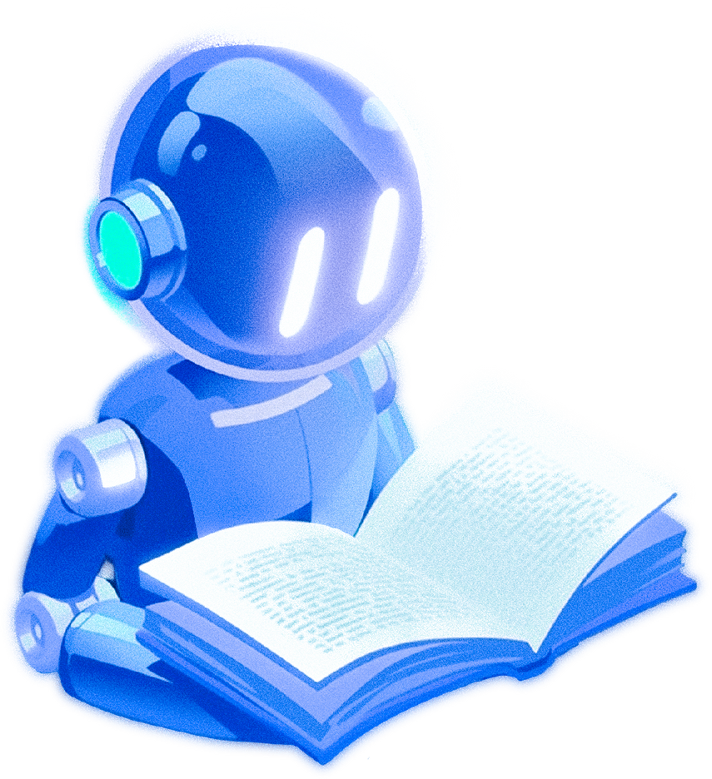

LU CHATBOT
MARIA HUSSEIN
MARIAH SANDAKLI

Slide 2


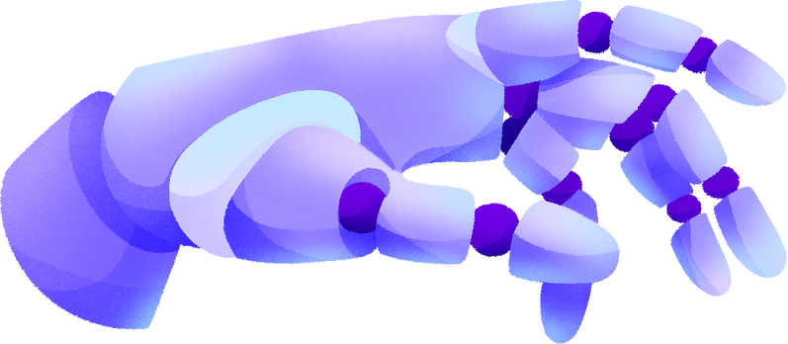


LU FACULTIES CHATBOT
- An intelligent conversational agent built using Google Gemini, a powerful Large Language Model (LLM).
- Utilizes the Retrieval-Augmented Generation (RAG) technique to improve the accuracy and relevance of responses.
- Leverages various components from the LangChain framework for integration of information retrieval and response generation.
- Designed to provide accurate and relevant responses to user queries related to the faculties at Lebanese University.

Slide 3


DEVELOPMENT PROCESS
Large Language Model
1
Google Gemini Chat Model
An LLM model used to generate responses to user queries.
Gemini is based on the transformer architecture, that rely on self-attention mechanisms, which allow the model to process input sequences in parallel and capture relationships between words over long distances.

Slide 4
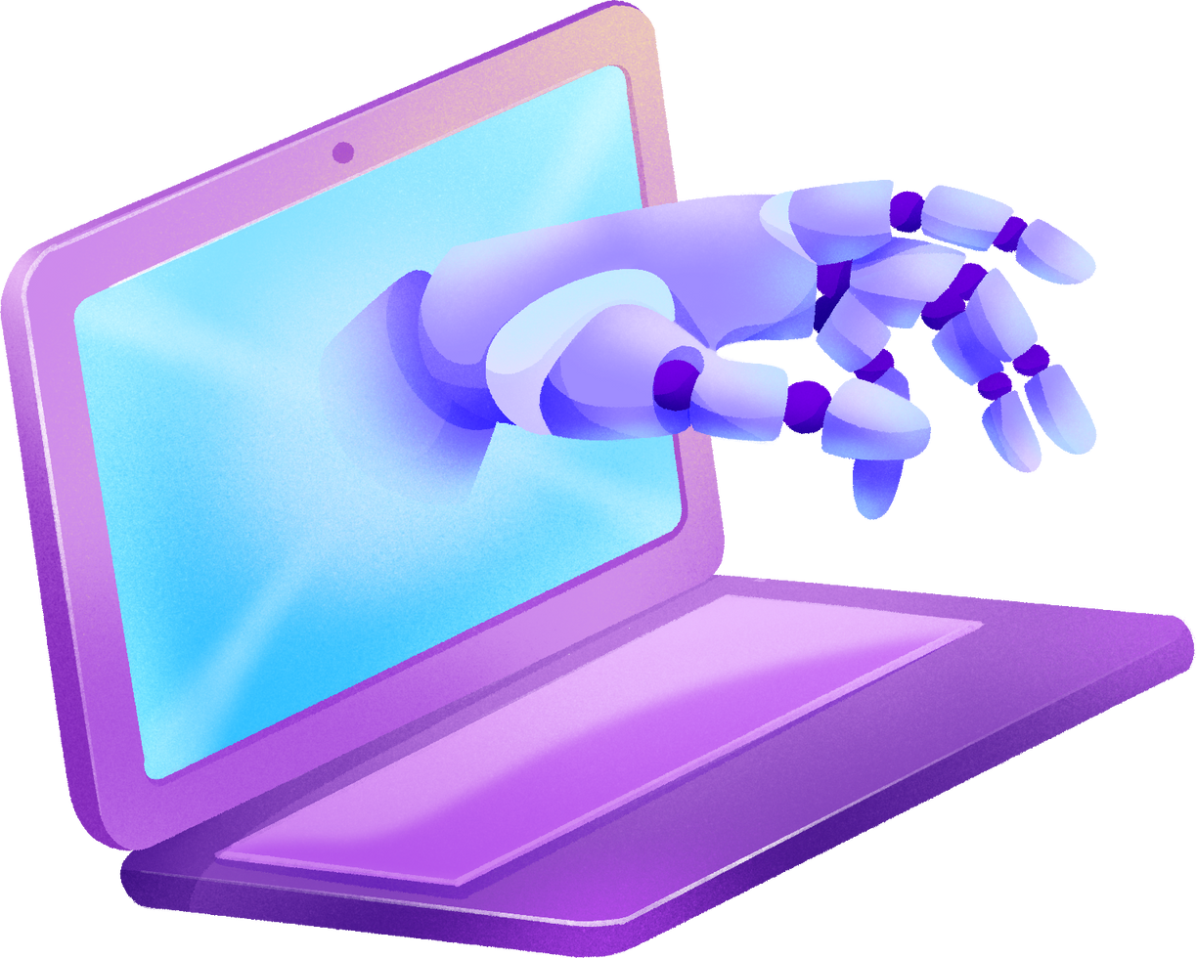
LangChain Framework
Chat Google Generative AI
Allows user interaction with Google’s generative Ai model ‘Gemini’ via API
API key is injected into environment of the program to allow communication with Google Gemini’s API.
2
3
Web Base Loader
Load content from the specified web pages by scraping them. It retrieves HTML code, parses it to extract useful text (such as paragraphs, headings), and converts the content into Document objects containing the extracted text.

Slide 5
4
Text Splitters
Langchain component used to split large documents into smaller chunks based on size (1000 characters) to ensure that documents can be processed and embedded without overwhelming the model or vector store.
5
Embedding
Langchain method that converts chunks of documents into numerical vectors (embeddings). These embeddings can be stored in a vector database for semantic search.
6
Vector Store
Langchain component that stores embeddings of documents. Chroma is a tool used to create and manage the vector database that stores these embeddings. The Chroma client is used to interact with the vector store.
7
Retriever
Langchain component that fetches the most relevant document chunks from the vector store based on user queries. It retrieves documents based on their semantic similarity to the query.

Slide 6

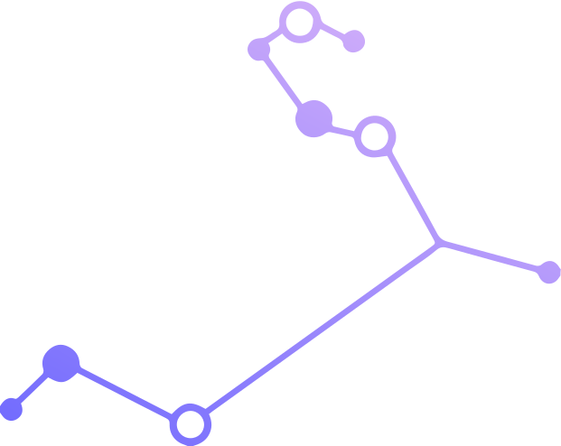
Prompt Engineering
8
Involved in the RAG chain to craft or apply predefined prompts (from LangChain Hub) to guide the model in generating more accurate or relevant responses.
The model is specifically tasked with question-answering tasks.
It is instructed to use the provided context to answer the question. This means the model should not generate a response purely based on its internal knowledge, but instead should rely on external retrieved context.
You are an assistant trained to provide answers based on the context provided. You are given several documents that may contain relevant information about the user’s query. Your task is to generate a detailed and accurate response using the information from the documents.
Context: {context}
Question: {question}
Answer:

Slide 7
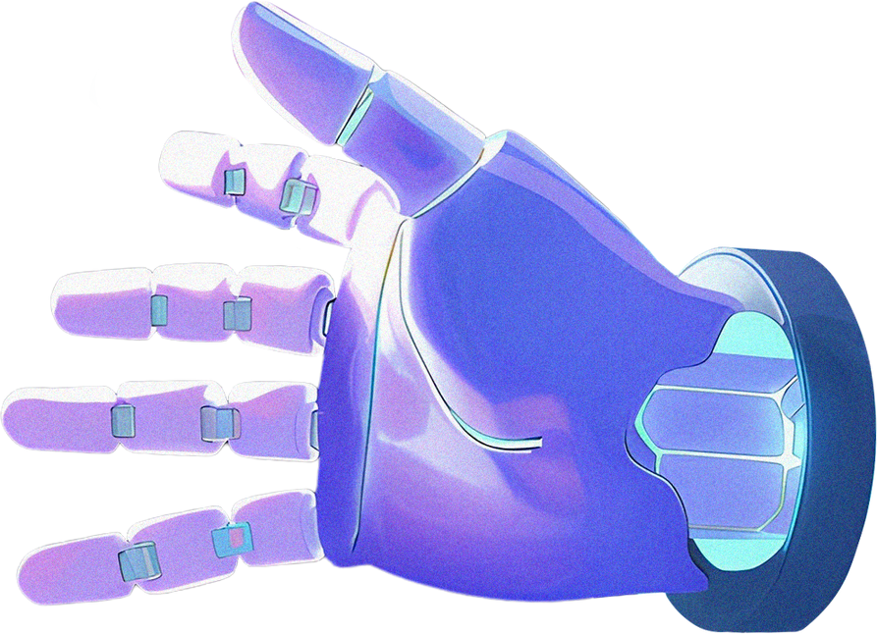
All these operations are sequenced in a RAG Chain
Context Retrieval (retriever)
Document Formatting (format_docs)
Prompt Definition (prompt)
Response Generatio (ChatGoogleGenerativeAI)
Response Parsing (StrOutputParser)

Slide 8

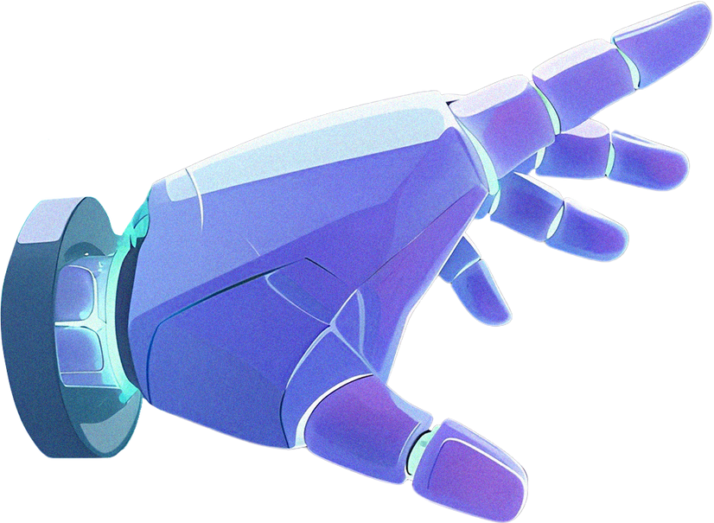

Streamlit Framework
Streamlit is used to build the user interface (UI) that allows users to interact with the chatbot. It facilitates easy creation of web-based applications for real-time interaction with the model. It includes an input form for user queries and displays the chatbot’s responses.
Streamlit’s session state is used to store the chat history to keep track of the ongoing conversation between the user and the bot.

Slide 9

Challenges Encountered
Web Scraping & Dynamic Content
Scrapy failed to scrape the faculty websites due to frequent changes in the HTML code.
WebBaseLoader performed better in this case as it has built-in support for dynamic content and can handle anti-scraping measures more effectively.
1
2
External Dependencies
The code relies on several external libraries (langchain, chromadb, ...) which lead to versioning issues.

Slide 10
Responses Evaluation
1
accurate, specific & relevant to the context of the user queries
2
clear, well-structured & easy to understand
3
The answers are related in the sense that the chatbot relies on the chat history
4
For questions with unknown answers, the chatbot responds with, "I don't have an answer to your question."

Slide 11

THANK YOU!
We appreciate your time and attention.

